Slide 1
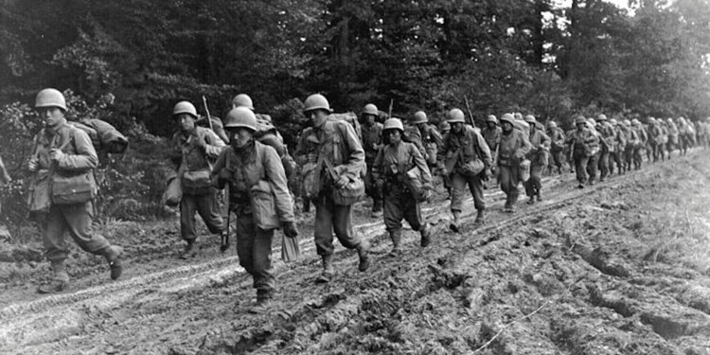
Impact of WWII to 1941 The impact of World War II on American capitalism The armaments industry Other industries Foreign affairs and trade Women in the workforce

Slide 2
The story so far…
1865-1900
1900-1918
1918-1920
1920-1929
1929-1941

Slide 3
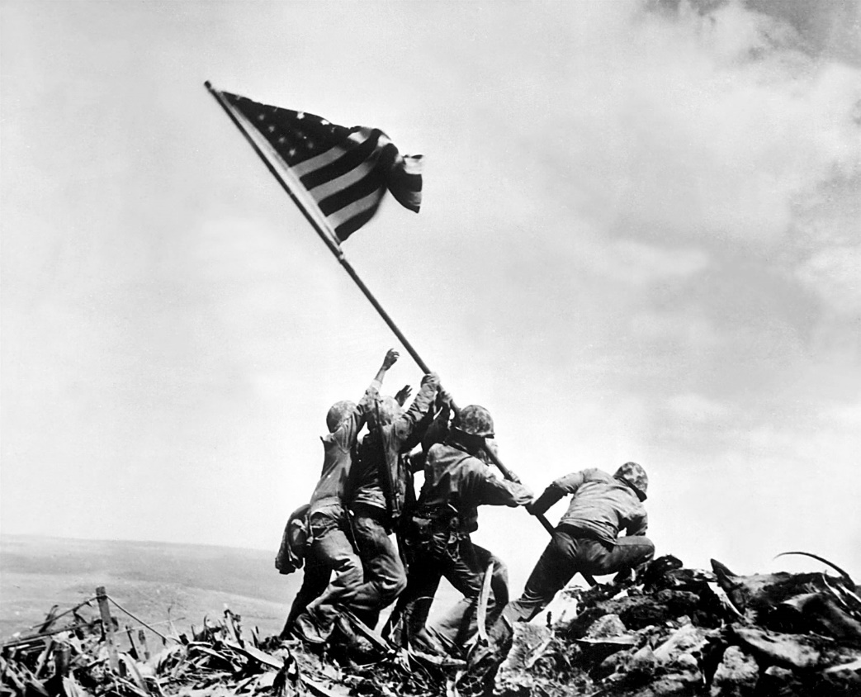
Background info
WWII broke out Europe 1 Sep 1939
Ended 2 September 1945
Began with invasion of Poland by Germany (Hitler) although there were many underlying tensions before this
Credited with end of Depression in USA

Slide 4
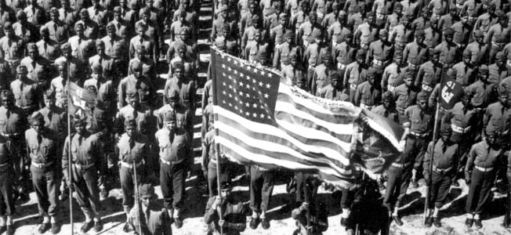
WW2 Oversimplified
Part 1: https://www.youtube.com/watch?v=_uk_6vfqwTA
Part 2: https://www.youtube.com/watch?v=fo2Rb9h788s

Slide 5
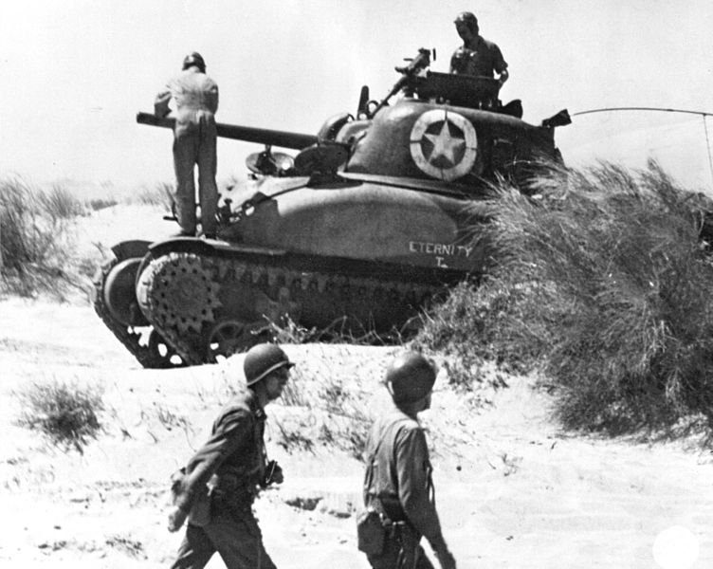
The impact of World War II on American capitalism
Restored prosperity in US
Unemployment reduced to 1%
Industrial output rose by 50%
Agricultural output rose by 30%

Slide 6
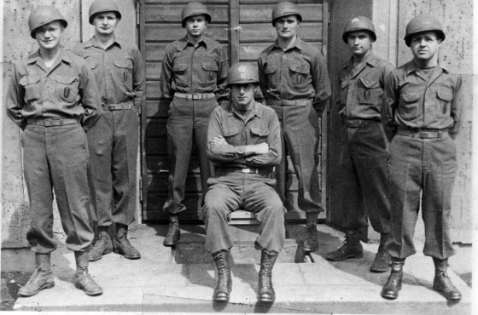
The armaments industry
The USA became the ‘Arsenal for Democracy’
3 million machine guns
87,000 tanks
Development of the atomic bomb – the Manhattan Project

Slide 7
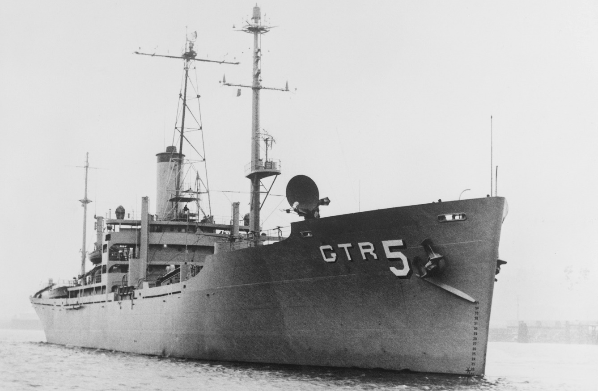
Other industries
Enormous technological advances
Radar enhanced by US engineers
The ‘valve driven’ computer developed
Synthetic rubber and magnesium manufactured
Shipbuilding revolutionised (‘Liberty’ and ‘Victory’ ships)
The domestic impact of the war lead to post-war prosperity and global economic power in the US

Slide 8
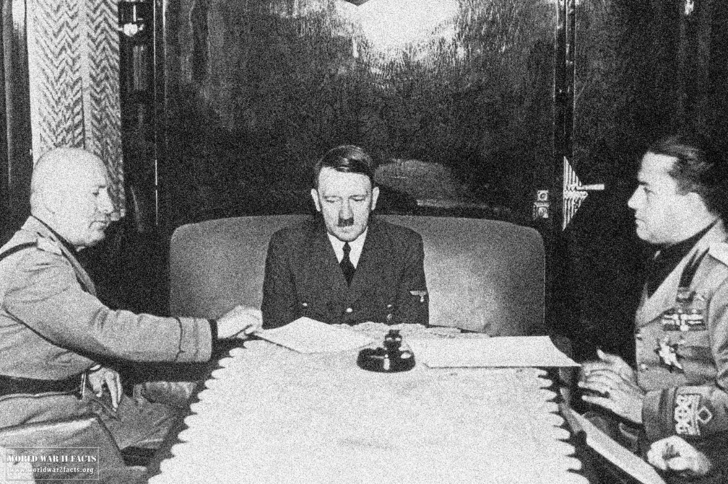
Foreign affairs and trade
During 1920s US isolationist
Relations with Tripartite Pact, or Axis Powers – Germany, Japan and Italy deteriorated steadily during the 1930s.
Sino-American relationships through trade and security
US-Japanese relationships deteriorated during early 20th C.

Slide 9
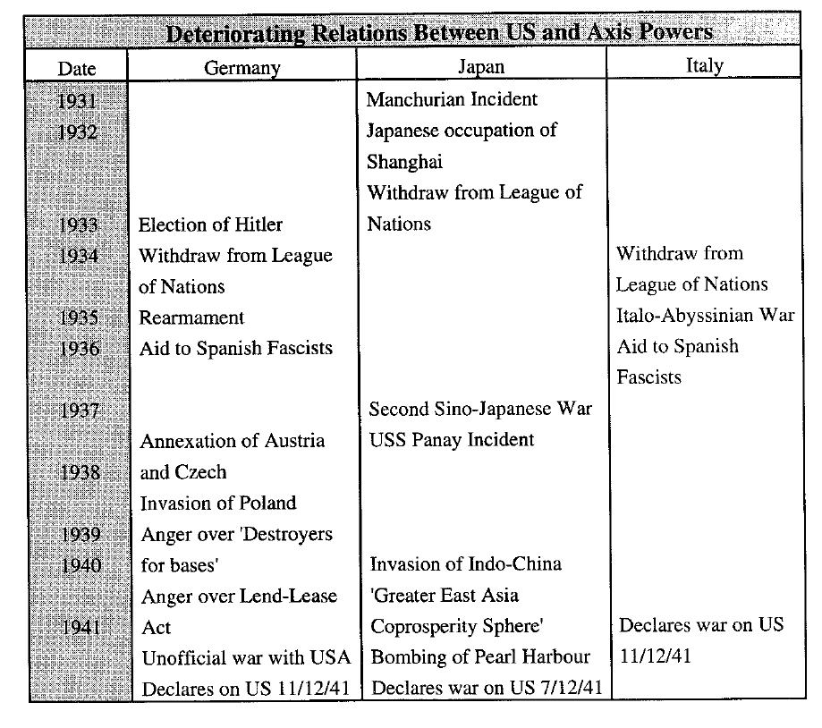

Slide 10
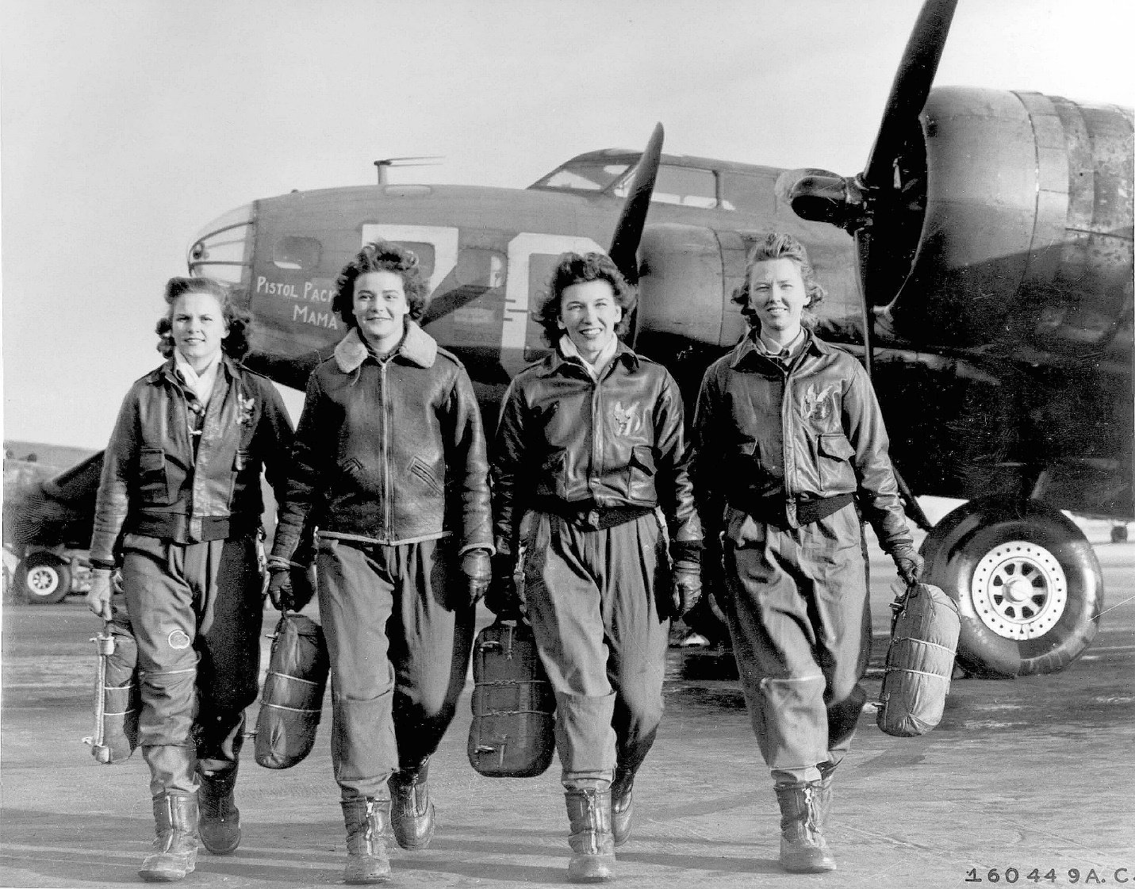
Women in the workforce
Women made economic gains
Around 2 million women employed in war productions industries
Women entered jobs previously reserved for men
Female participation in the workforce rose from 12 million to 16 million
Unlike WW1, when men returned from overseas women did not suffer wholesale redundancies

Slide 11
Key questions
Why do you think the U.S. maintained a position of neutrality in World War II for so long?
What was the role of the U.S. in this conflict before the official declaration of war?
Was war between the United States and Japan inevitable?
Was World War II a “good war?”
Discuss the reasons why WW2 was such a significant event for the United States.

